Slide 1



PEILab Group Meeting
Leader: Zicong Hong
Team Member: Jian Lin, Haodong Wang, Qianli Liu, Kaibin Guo, Junjie Liu

Slide 2
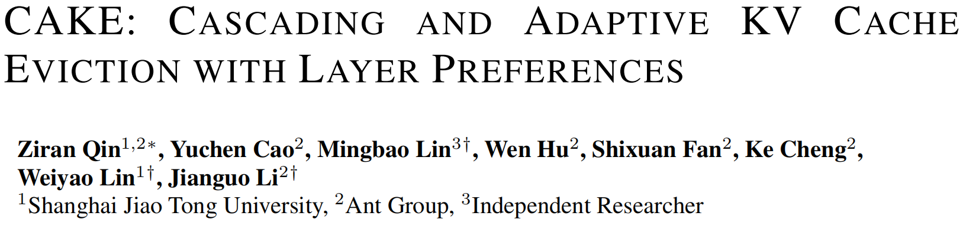
CAKE
ICLR 2025

Slide 3
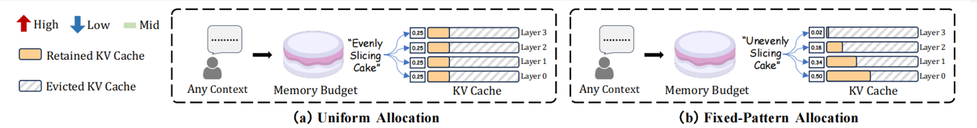
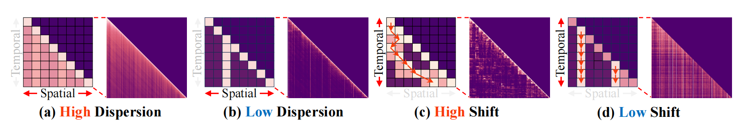
CAKE

Slide 4
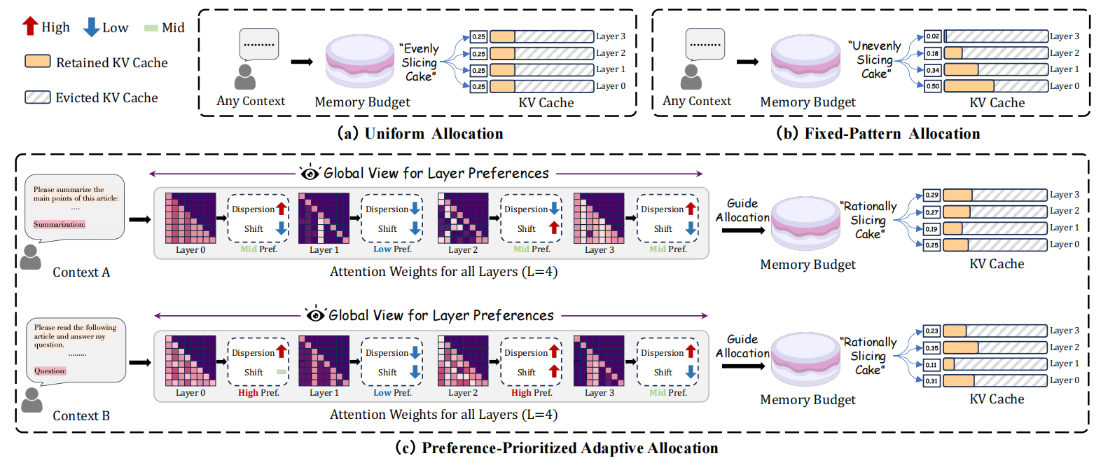

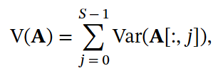
CAKE

Slide 5
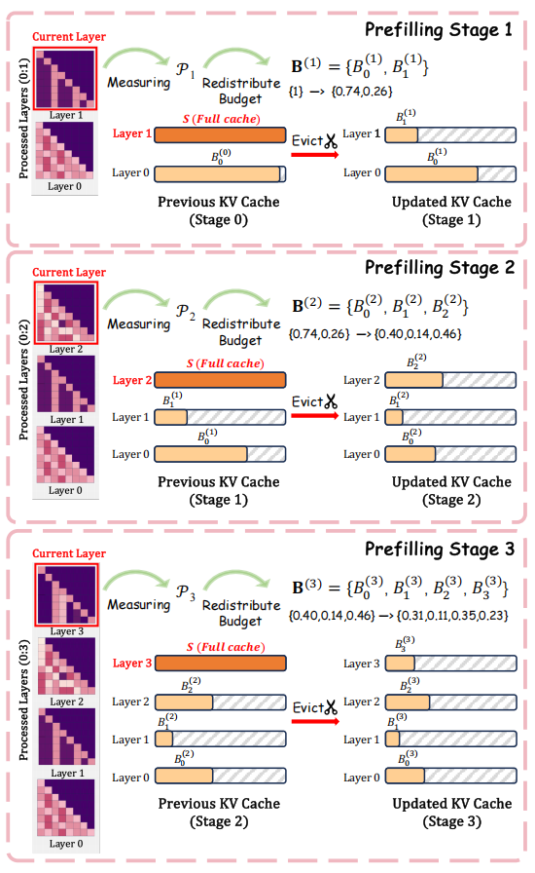
CAKE
PREFERENCE-GUIDED CASCADING CACHE MANAGEMENT
ATTENTION-SHIFT TOLERANT EVICTION INDICATOR

Slide 6
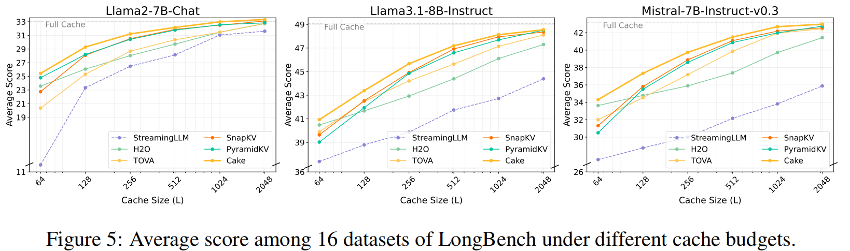
CAKE

Slide 7
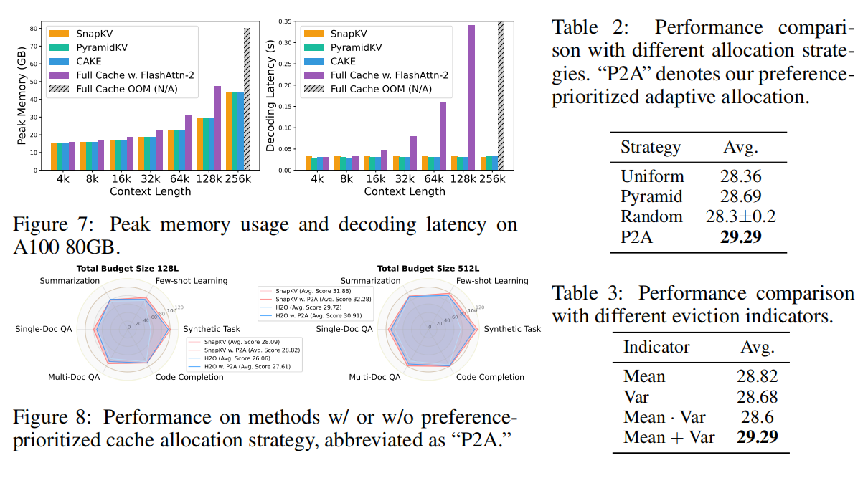
CAKE

